Slide 1
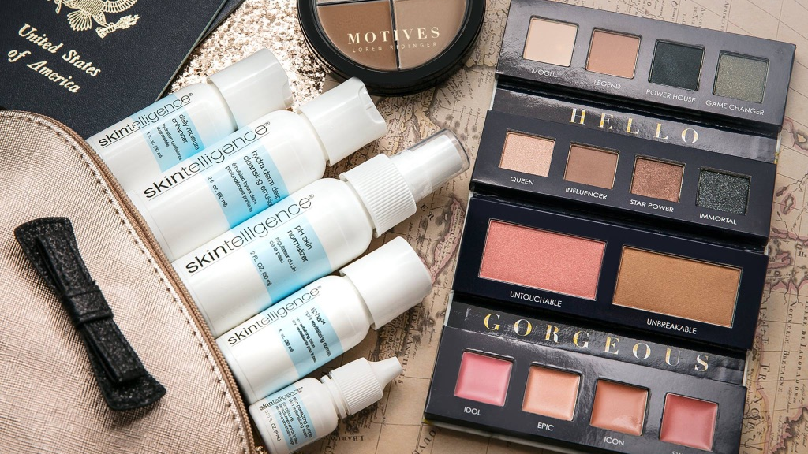
The Art of Makeup-
Guided Application Workshop
GET THE LOOK

Slide 2
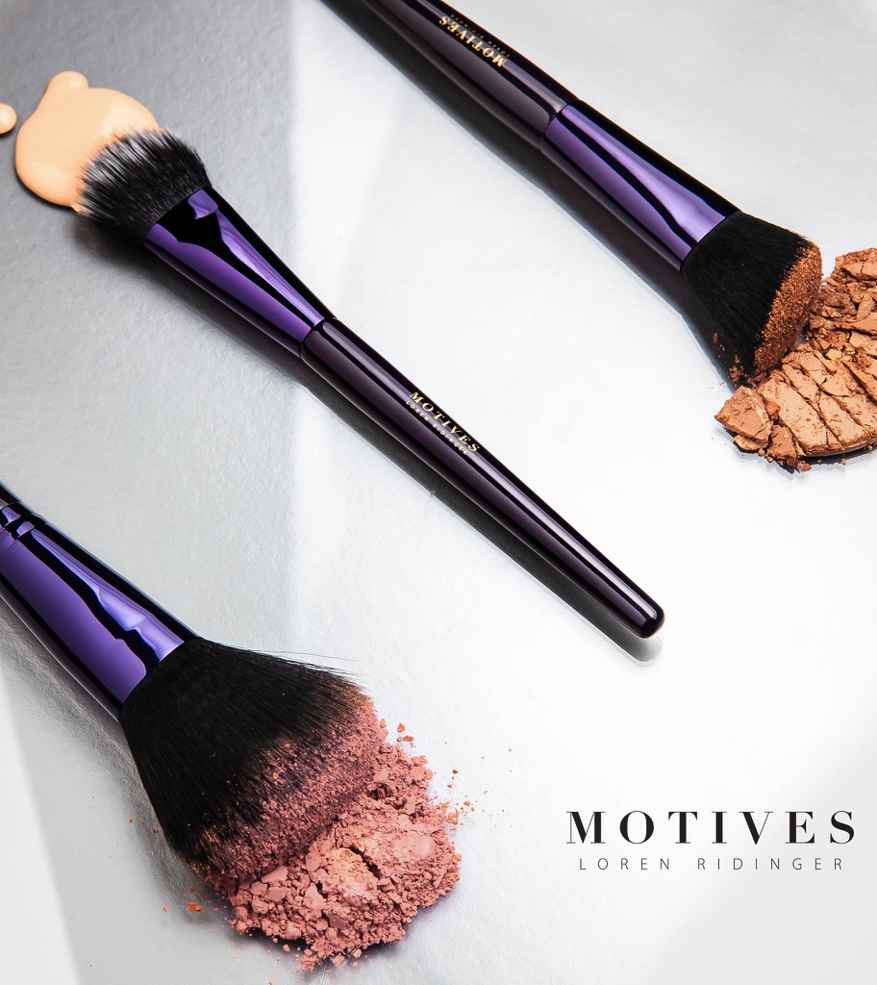
PREPARATION
is KEY

Slide 3
We are advocates for being prideful in all things! And having a beautiful station that pairs as an efficient workspace is one of those things. If you’re organised, you’ll feel more in control and your sanitation and pack up at the end of the session will be simpler.
Motives
Proper Set-Up
BENEFITS
Saving time!
Being more efficient
Feeling in control and less chaotic
Ability to focus on YOU
Learning (by doing) how to conduct a client consultation!
Duplication by default

Slide 4
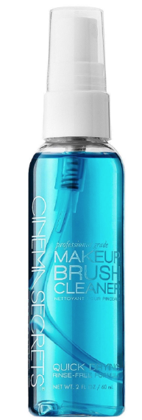
We are here to learn how to accentuate our natural beauty, but things can get ugly real fast if we don’t take the proper steps to care for our beauty-enhancing tools.
When working on a client, sanitation is taken to another level. But even when working on yourself
Motives
Sanitation Station
STATION ESSENTIALS
Hand Sanitiser
Brush Cleaner
Alcohol Spray
Sharpener
Stainless Steel Palette

Slide 5
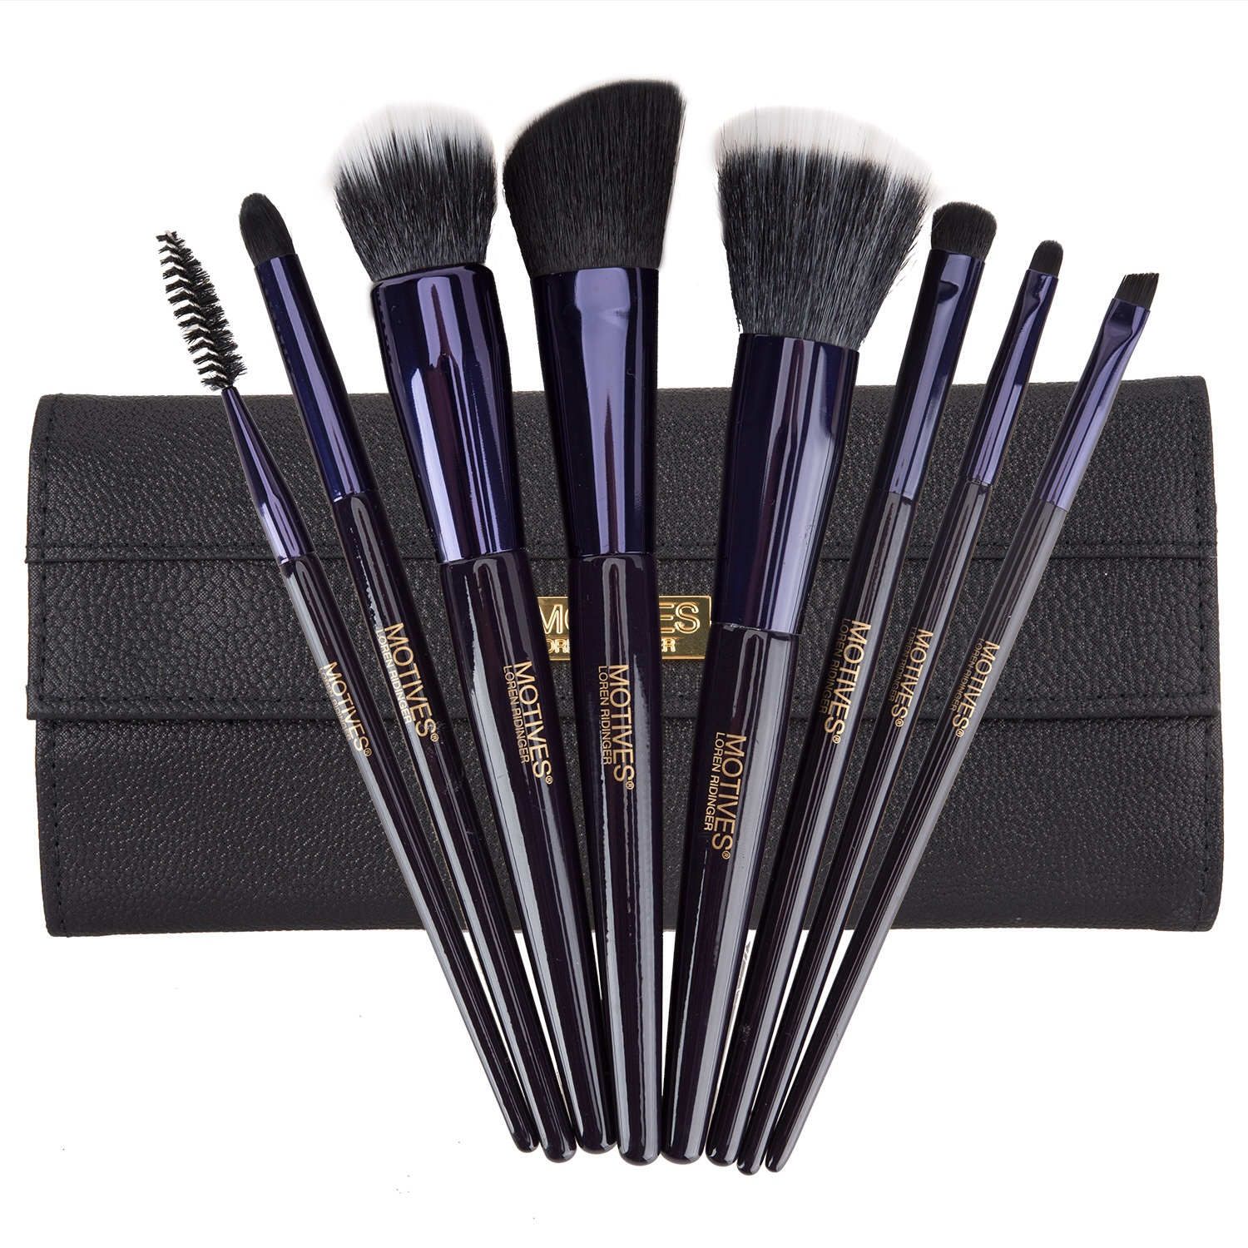
This brush set contains eight of the best beauty tools of the trade. Each brush is specially designed with firm bristles for high-definition makeup application of face, eye and lip cosmetics. Master the latest trends from naturally flawless to a smokey eye with brushes that deposit just the right amount of product.
Motives
8-Piece Deluxe Brush Set
BENEFITS
Includes eight brushes for complete application of face, eye and lip cosmetics
Chic, black case with magnetic closures that keep brushes clean and organised
Brushes are composed of goat hair and synthetic fibers

Slide 6
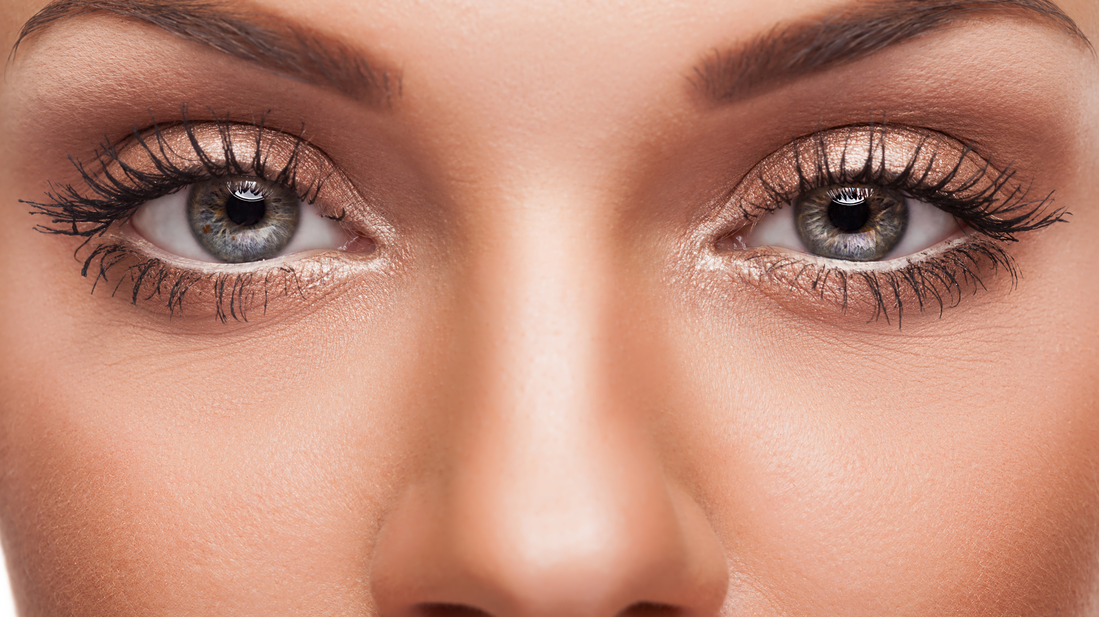

ALL ABOUT EYES

Slide 7
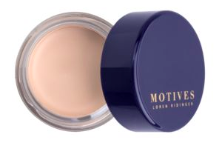
STEP 1: APPLY
A creamy, weightless formula that helps smooth and even the complexion of the eyelid, creating a perfect canvas for eye makeup. This formula extends the wear of eye shadow, helps prevent creasing, and makes shadow colours more even, intense, brilliant-looking, fresh, and just-applied all day.
Motives
Eye Base
SKU: 7SB01
$22.50
BENEFITS
Smooths and neutralises the eyelids
Keeps eye shadow from creasing
Eye colour stays true

Slide 8
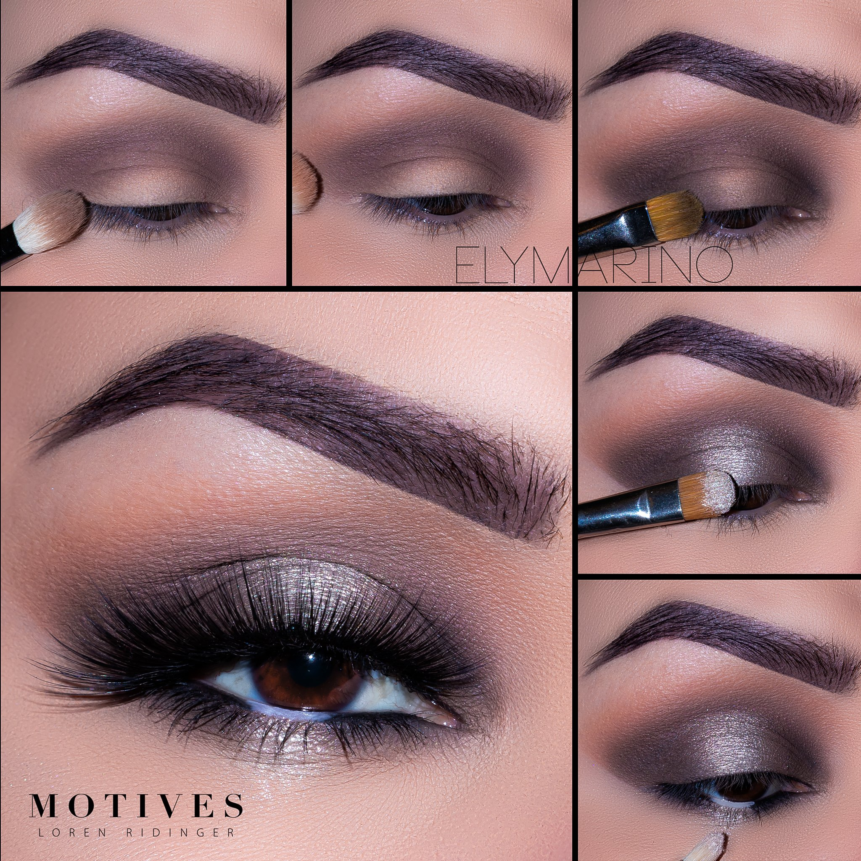
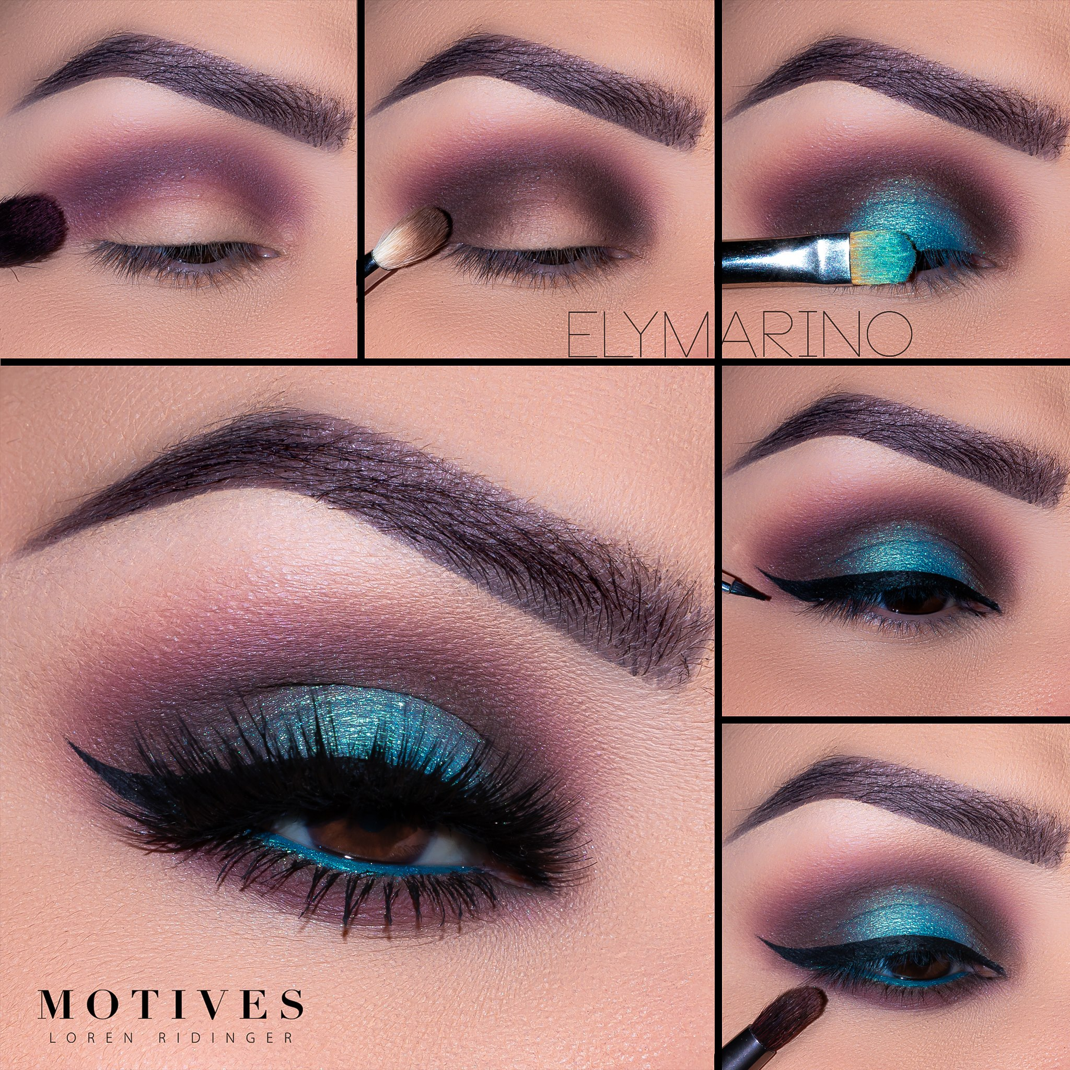
GET THE LOOK
or
Play it Safe
Be Bold

Slide 9
Play it Safe
Uncover your natural beauty with Demure, a Mavens palette of 10 barely-there shades. Hand selected by the top makeup artists in the world for its universally flattering hues and incredible wearability, Demure is an essential palette of super sexy nudes that is anything but uninspiring.
Motives Mavens Demure
sku: 710PDEM
$50.25
BENEFITS
Chosen by Motives Mavens as universally flattering hues for every woman
10 barely-there shades for creating natural looks with subtle dimension
Matte and pearl finishes with incredible wearability that blend effortlessly
Perfectly sized for glamorous looks on-the-go

Slide 10
Be Bold
Sensuous and bold beauty defines Dynasty, a Mavens palette of 10 power-invoking shades. Hand selected by the top makeup artists in the world for its daring hues and versatility, Dynasty is a colourful palette of unguarded shades that evoke your inner-goddess.
Motives Mavens Dynasty
sku: 710PDYN
$50.25
BENEFITS
Chosen by Motives Mavens for its colourful hues
10 daring shades for creating sensuous, bold looks
Matte, pearl and glitter finishes with incredible wearability that blend effortlessly
Perfectly sized for glamorous looks on-the-go

Slide 11
Play it Safe
Be Bold
STEP 2:
TRANSITION COLOUR
The purpose of this step is to seamlessly "transition" from your mobile lid or crease to highlight shadows. Shadow colour used for this step depends on skin tone and the look you want to create, but is usually a warm shade slightly darker than your natural skin tone and blended along the brow bone.
Using a blender brush Begin by blending “Bare” slightly above the crease
Using a blender brush Begin by blending “Electra” slightly above the crease

Slide 12
Play it Safe
Be Bold
STEP 3:
CREASE
The purpose of the crease shade is to create depth and dimension. It’s usually the darkest shade and is placed below the transition colour. The crease is identified as the space along the edge of the brow bone where the eye socket meets the mobile lid.
Using a crease brush, blend “Lush”
into the crease
Using a crease brush, blend “Nefertiti”
into the crease

Slide 13
Play it Safe
Be Bold
STEP 4:
OUTER CREASE
The purpose of the crease shade is to create depth and dimension. It’s usually the darkest shade and is placed in the shape of a sideways "v" (<) on the outer mobile lid and blended into the crease. The crease is identified as the space along the edge of the brow bone where the eye socket meets the mobile lid.
Using a crease brush, blend “Teddy” in the outer corner of the eye. To add depth apply “Lights Out” to the very outer corner swiping on the lower lash line
Using a crease brush, blend “Nefertiti”
into the outer corner of the eye and blend “Electra” on the lower lash line

Slide 14
Play it Safe
Be Bold
STEP 5:
MOBILE LID
The "mobile lid" is the entire space that covers your eyeball. The purpose of this step is to add colour if so desired. In a typical 3-step application, this is usually the medium shade. Shimmer or glitter is also often applied here.
Using a flat shadow brush Pat “Pure” onto the center of the lid
Using a flat shadow brush Pat “Cleopatra” onto the center of the lid

Slide 15
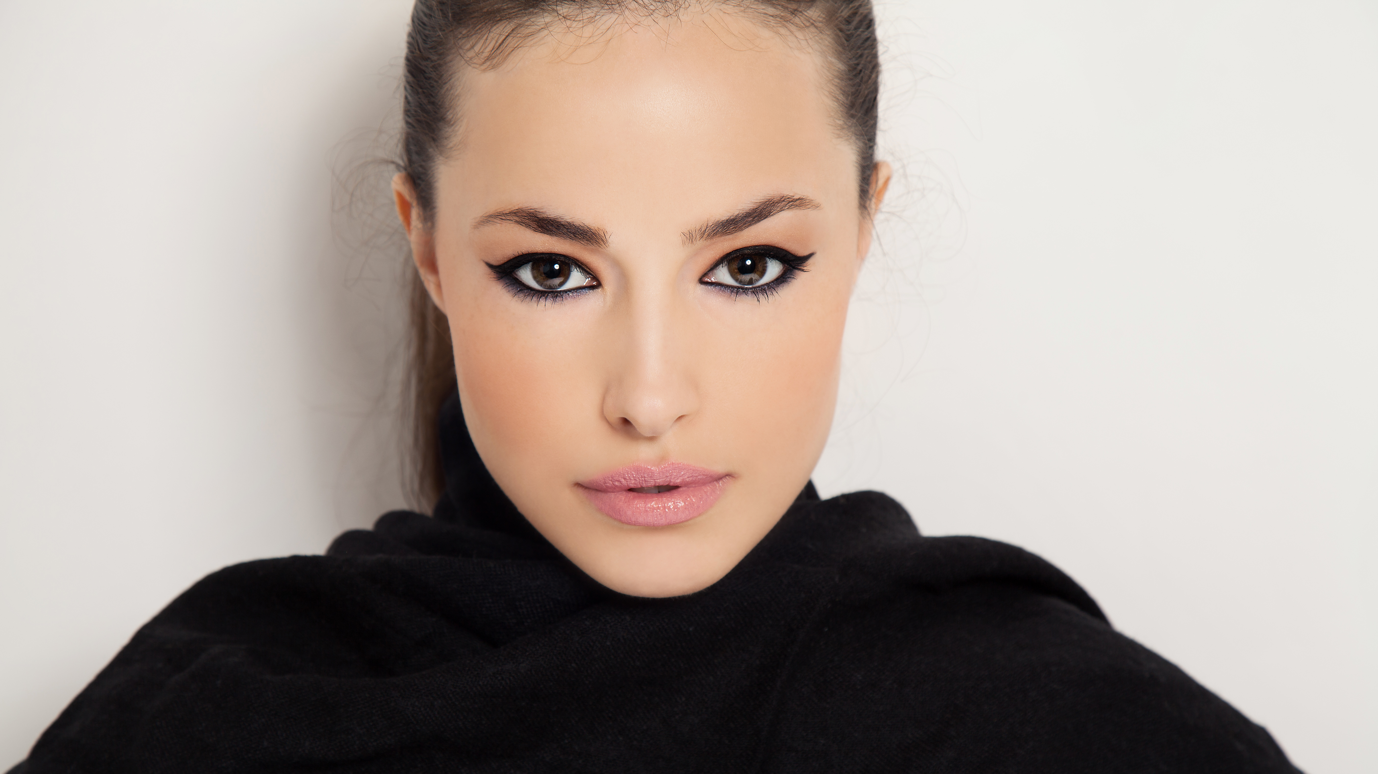
EYE LINER
OPTIONS

Slide 16
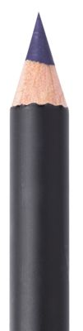
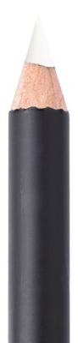
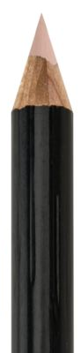
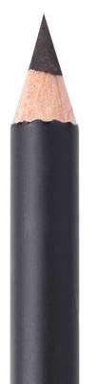
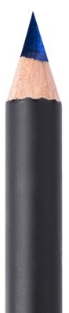
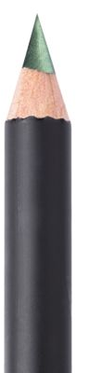
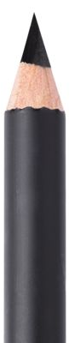
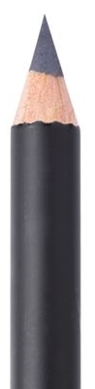
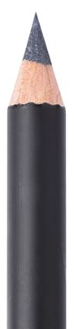
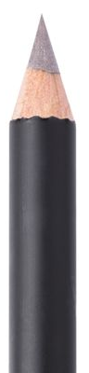
Motives
$22.50
Khol
Mineral-based formula with smooth and creamy texture that glides on the eye with ease
Intensely pigmented, luscious colours that define and shade the eyes
Long-lasting wear
Crayon applicator glides with ease
Creates precise or blended lines for captivating eyes
Ideal for natural or smokey eye looks
Eyeliner
Code Varies

Slide 17
Motives Luxe
Precision
Eye Line
Jet Black– 723ELP
$20.75
Waterproof, long-lasting formula
Velvet touch precision tip for accurate application
Will not scratch, tug or slip
Available in neutral colours that will enhance your eyes’ natural beauty

Slide 18
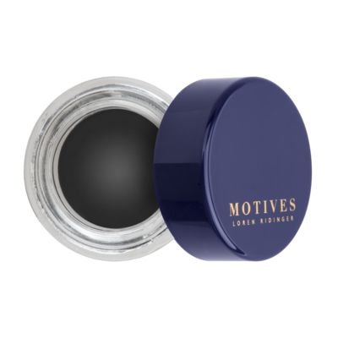
Motives
Mineral Gel
Eyeliner
Little Black Dress – 7002GEL2
$23.50
Delivers a luxurious, silky smooth application
with a simple swipe of the brush
Natural mineral pigments balance and maintain healthy skin while providing long wear
Available in neutral colours with a pearlised finish and rich application that are talc, paraben and fragrance free

Slide 19
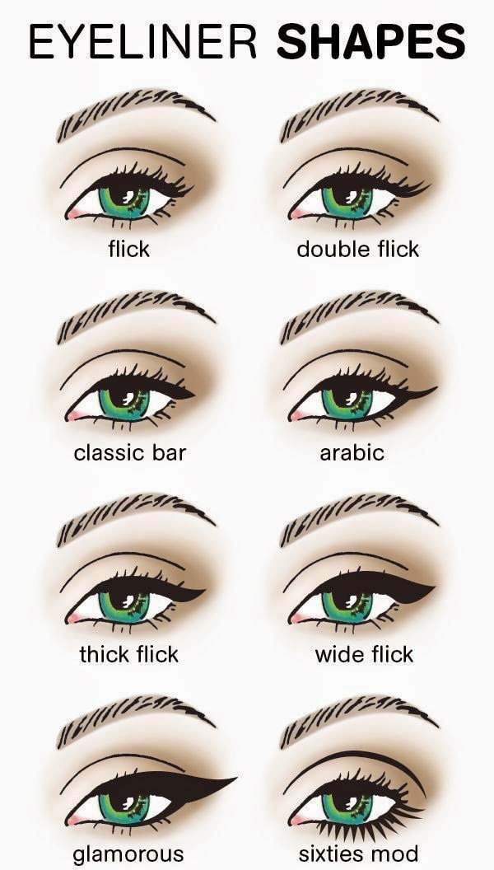
STEP 6:
APPLY EYELINER
Eyeliner can be drawn above upper lashes, below lower lashes or both, even on the water lines of your eyes. Its primary purpose is to make the lashes look lush, but it also draws attention to the eye and can enhance or even change the eye's shape.

Slide 20
STEP 7: CURL Motives
Eyelash Curler
sku: 720128
$16.00
A favourite of makeup artists everywhere, an eyelash curler is truly a girl’s best friend. It gently clamps around your lashes, making them reach for the sky. Precise engineering applies the perfect amount of pressure on eyelashes and will not pinch your eyelid. Instantly opens the appearance of the eye and prepares the lashes for mascara application.

Slide 21
STEP 8:APPLY Motives
EYELASH PRIMER
A conditioning base that makes every lash stronger and longer. The moisturising formula helps to mend dry lashes for full, extended wear.
SKU: 7100LP
$23.50
BENEFITS
Conditioning formula volumises
and lengthens lashes
Goes on creamy and smooth
Adds texture to lashes so they appear thicker and fuller
Strengthens lashes
Flake-free formula

Slide 22
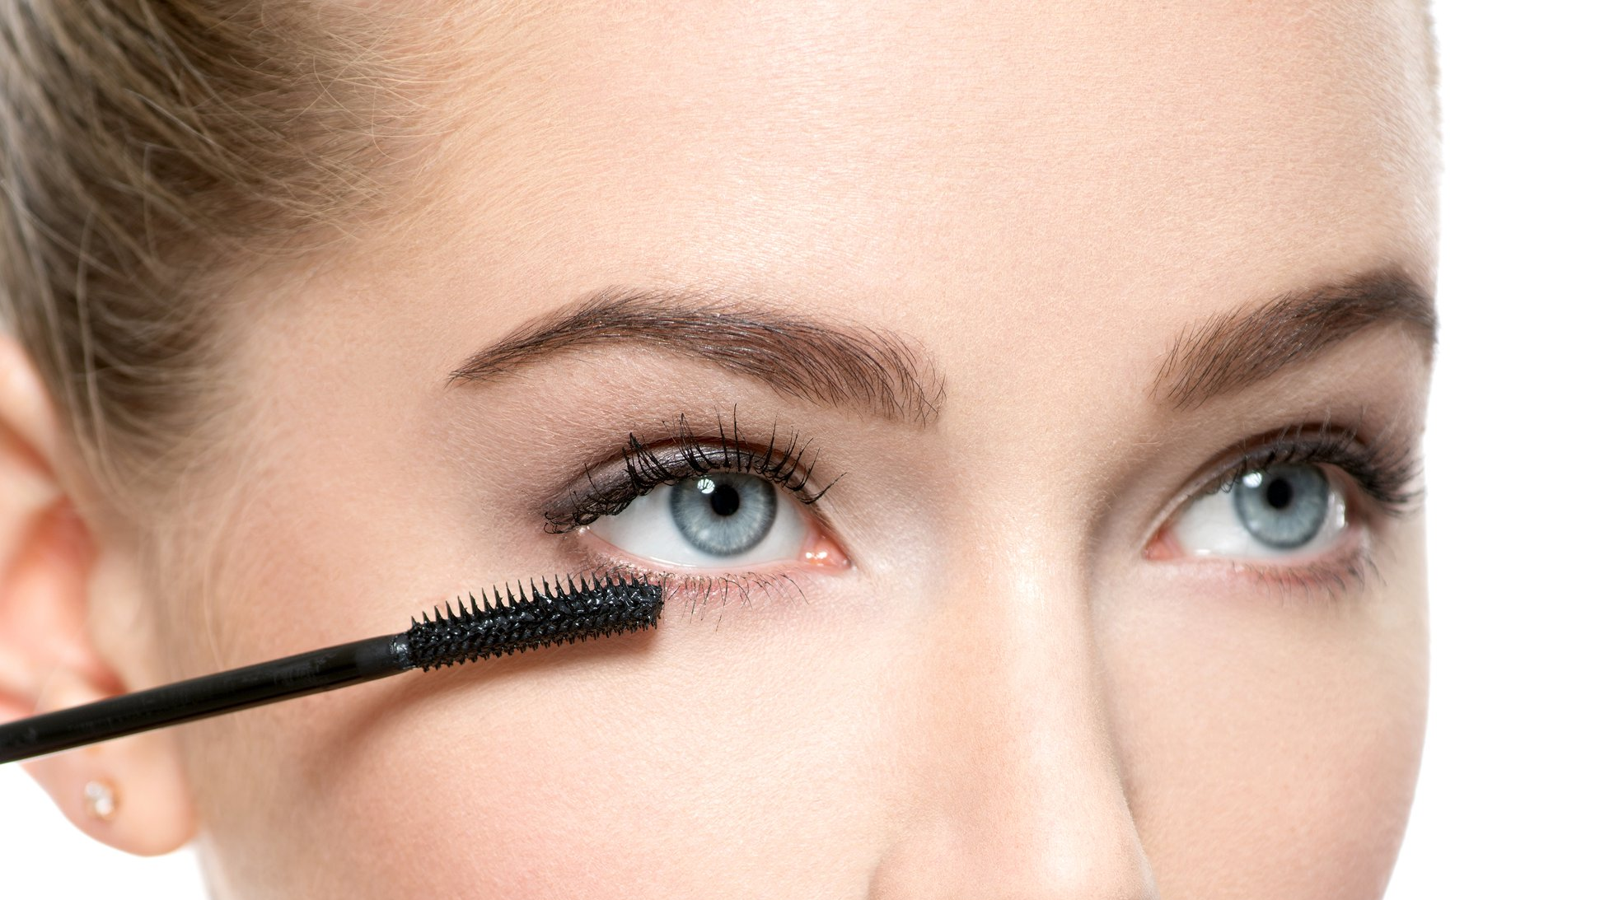
STEP 9:
MASCARA
Mascara is a cosmetic commonly used to enhance the eyes. It may darken, thicken, lengthen, and/or define the eyelashes.

Slide 23
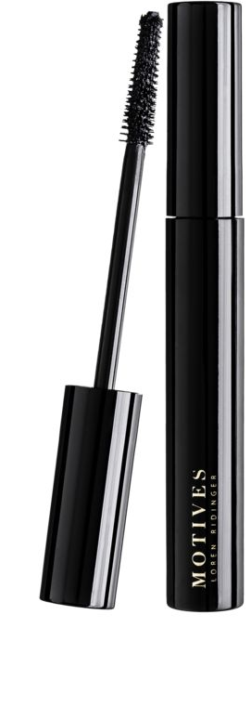
Motives
FIBER LUSH
Mascara
Sku: 7100MFLM
$36.75
Designed with fibres that adhere to your lashes, creating a bold false-lash look
Full bristle brush grabs the lashes from root to tip for instantly thicker-looking lashes
Builds lush, dramatic volume for a clump-free, gorgeous look
Creates lashes that resist smudging and flaking

Slide 24
Motives for
La La Volumizing
& Lengthening
Mascara
Black – 7100MLM
$26.75
Exquisite, rich, mineral based formula builds
thick, beautiful lashes with every swipe
Pulls up and curls lashes without the need for
an eyelash curler
Hollow fibre brush allows for smooth, even application
Creates smudge-free, flake-free, celebrity lashes
Gentle on sensitive eyes

Slide 25
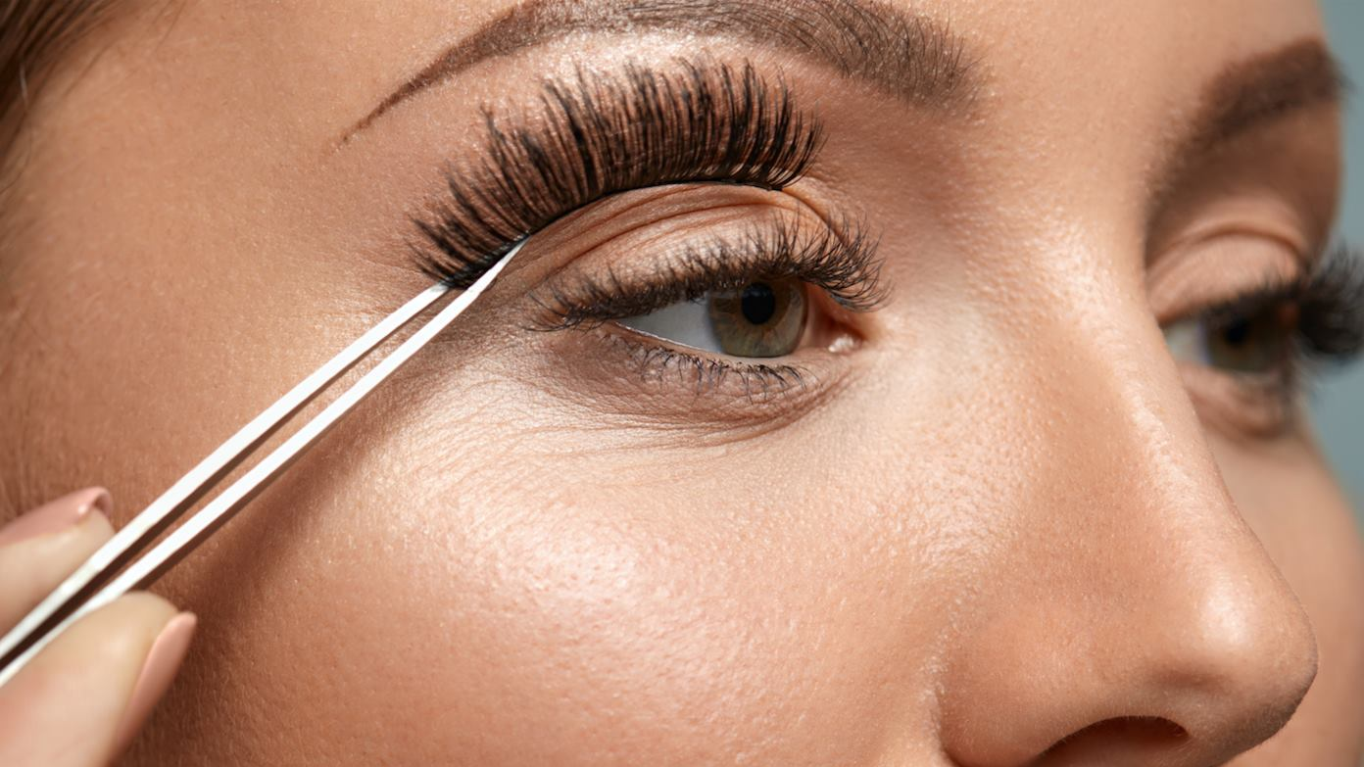
APPLYING FALSE LASHES

Slide 26
STEP 10: APPLYING FALSE LASHES
You Will Need One of the Following
Motives False Eyelashes
109
110
111
112
113


Slide 27

APPLYING FALSE LASHES
Follow Step by Step Pictorial
STEP 1
STEP 2
STEP 3
STEP 4
Hold the lash strip up to your eye to check the length – if it’s too long it will be uncomfortable
Trim lash to fit your lash line. Make the cut where the lash is the longest.
Take your false lash and bend it to create a c shape. Hold for a couple of seconds.
Apply the glue. Wait 30 seconds for the glue to become tacky (this will make the lash easier to place).
STEP 5
STEP 6
STEP 7
Gently Curl
your eyelashes.
Using tweezers (or your fingers) place the false lash as close as possible to your natural lash line.
Start in the center, then outer side and inner corner.
THE END
RESULT

Slide 28
APPLYING FALSE LASHES
Tips and Tricks
CUT LASH STRIPS IN HALVES OR THIRDS FOR EASIER APPLICATION
LEAN DIRECTLY OVER A MIRROR TO GET A BETTER VIEW

Slide 29
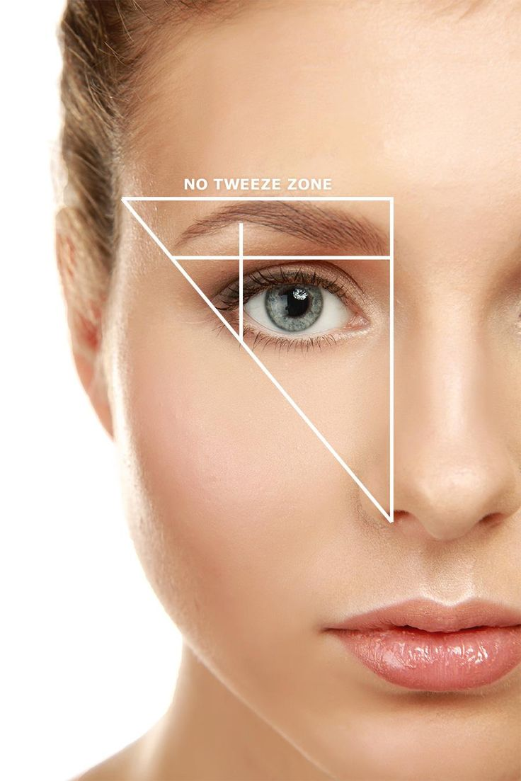
STEP 11: PERFECT BROWS
The structure that your eyebrows give to the rest of your face will flow and enhance your makeup and hair, so when looking good, they can give you the confidence to face the day!

Slide 30
Motives
  A complete kit for expertly shaping, grooming and defining your brows. The all-inclusive kit contains wax to sculpt the brows and two powder shades to create a natural look.
ESSENTIAL BROW KIT
sku: 7100MBK
$42.00
BENEFITS
Astonishing powder/wax brow combination that is effortless to apply and provides striking gleam
Apply the smooth powder for striking colour and the wax for brow-sculpting control with enhanced shine
Enjoy glamorous, shaped and sexy brows all day long

Slide 31
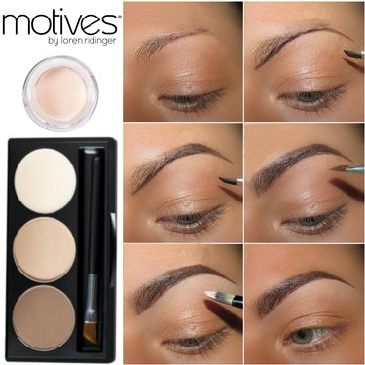
BEFORE
THE PERFECT BROWS
Follow Step by Step Pictorial
STEP 1
Mix some of the wax included in the kit with the powder matching your natural brows best (or simply mix both to receive a matching shade) & use it to outline the natural shape of your brows. You may correct the arch or thickness/length of your brow shape.
STEP 2
Fill in the outer part of your brow with the matching shade of powder
STEP 3
STEP 4
Fill in the rest of the eyebrow. You may use a lighter powder or use a brow comb to brush the colour in for a more natural look
Use the Eye Base to clean up your brows. You may also use a concealer matching your skin colour if the Eye Base should be too light
THE END
RESULT

Slide 32
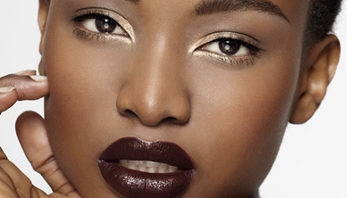
FLAWLESS FACE

Slide 33
Prime & Smooth
Prep your skin for foundation, while hydrating and nourishing. Taking time to do these steps will result in longer wear from your foundation and a more flawless application

Slide 34
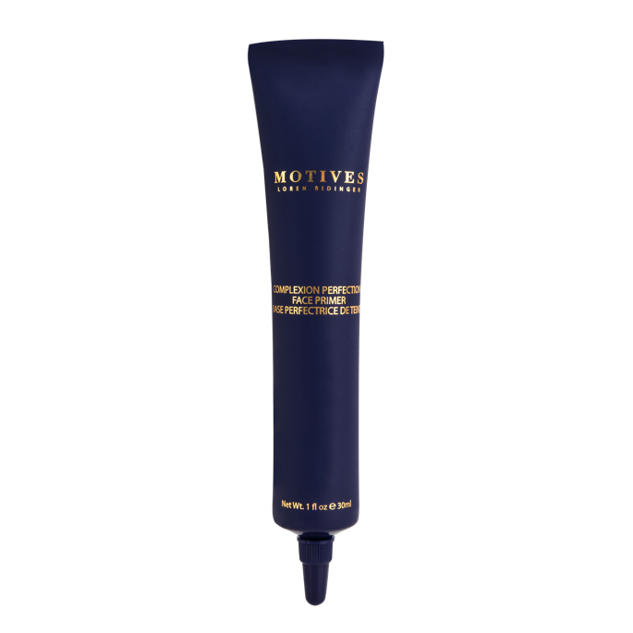
STEP 1: APPLY
Motives
  An innovative formula that targets pores, fine lines and wrinkles, Complexion Perfection Face Primer visibly reduces the appearance of imperfections for even-looking skin that is prepped and primed. This oil-free, smoothing formula extends the life of your foundation for the perfect, flawless look.
COMPLEXION PERFECTION FACE PRIMER
SKU: 7301FP
$31.50
BENEFITS
  Targets pores, fine lines, and wrinkles for a smoother-looking skin
  Reduces the appearance of imperfections
  Creates a barrier between your skin and foundation
  Helps your makeup stay on longer

Slide 35
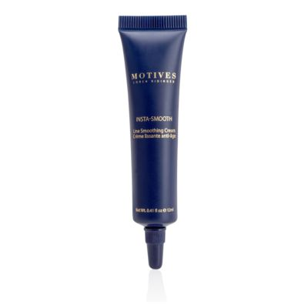
STEP 2: APPLY
  A powerful formula that minimises the appearance of fine lines and wrinkles while perfectly smoothing the skin. This formula creates a veil over the skin’s surface, providing a soft focus effect. Antioxidant ingredients promote healthy skin while the mineral pigments reflect light away from fine lines and wrinkles.
Motives
INSTASMOOTH
SKU: 7201LEG
$24.00
BENEFITS
  Fills in lines, creating a smooth surface for makeup application
  Mineral pigments reflect light away from fine lines and wrinkles
  Antioxidant ingredients promote healthy skin

Slide 36
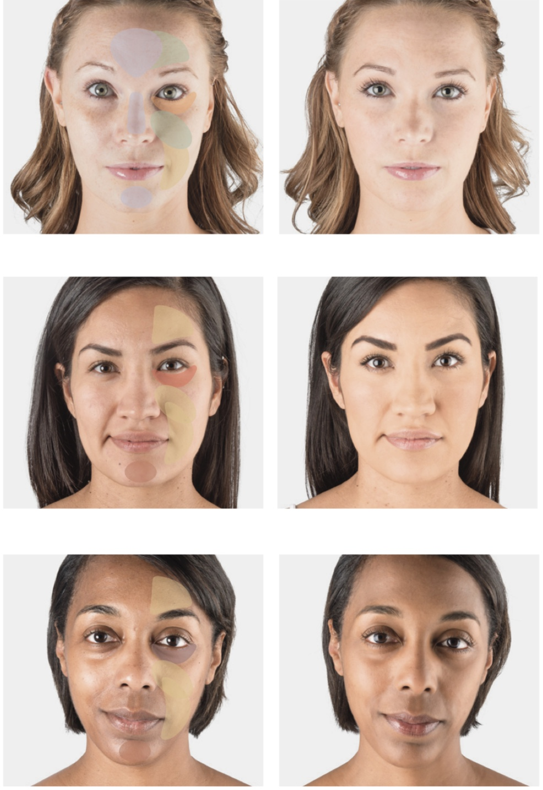
STEP 3: COLOUR CORRECT
You Will Need
Motives® Color Correction Quad: No. 1 (Light to Medium)
Motives® Color Correction Quad: No. 2 (Tan to Deep)

sku: 7200CCW
sku: 7201CCW
$47.95

Slide 37
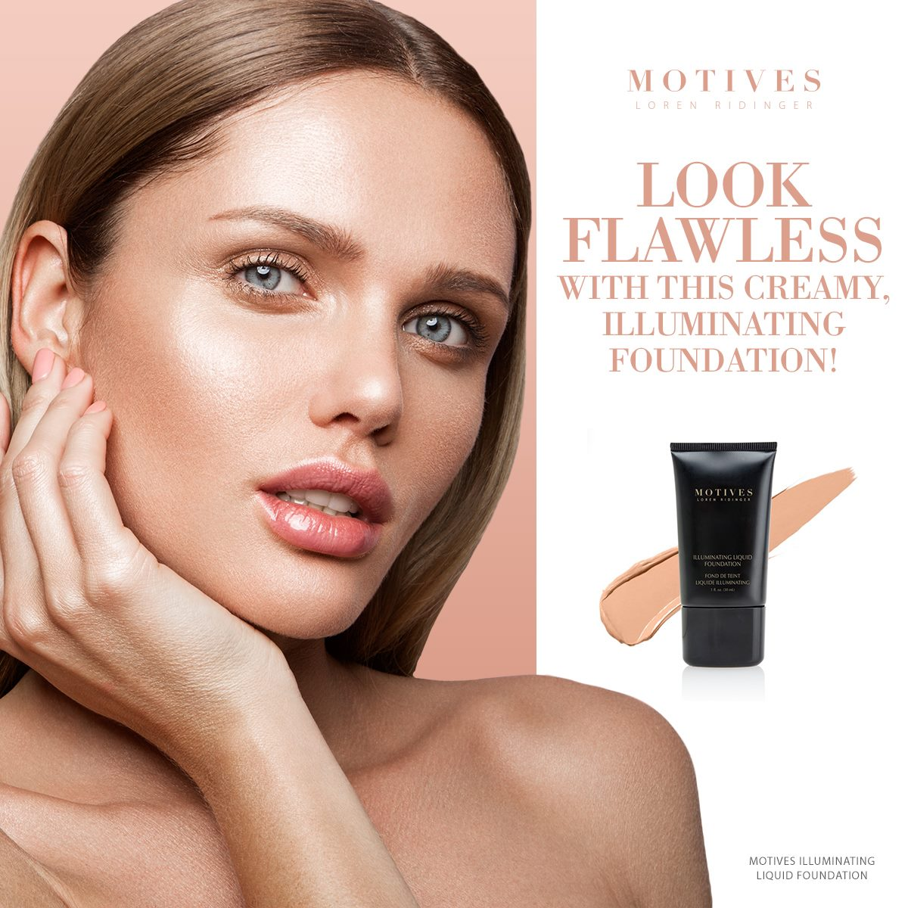
STEP 4: Foundation
Even out your skin-tone and provides a canvas for the rest of your makeup to be applied.

Slide 38
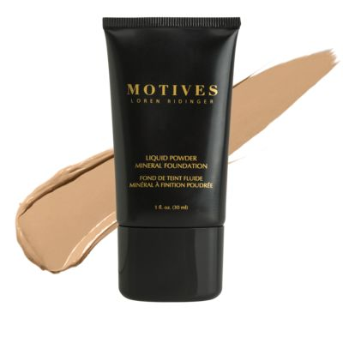
  A 3-in-1 foundation that provides the superior, buildable coverage of a crème foundation while offering a primer, with the natural-looking, sheer finish of a powder foundation. This foundation hides discolourations and covers skin with a fine, light-diffusing layer to minimise pores and imperfections for clear, satiny-smooth skin under any lighting.
Motives
Liquid Powder Mineral Foundation
Code Varies
$39.95
BENEFITS
  Created using the newest technology with a built-in invisible shield, rich polymers and silicone that protect the skin while smoothing out fine lines and wrinkles
  Exclusive multi-mineral complex helps protect skin and complements any complexion
  Vitamins C & E provide antioxidant protection and vitamin A conditions the skin
  One step process with primers and silicone in one formula
  Free of oil, wax, dye and talc
  Micro diffusers keep skin looking flawless

Slide 39
  An illuminating foundation that melts into skin leaving you with a radiant, flawless-looking complexion. The creamy, long-wear formula builds and blends effortlessly, leaving your skin with light-weight, natural coverage. Optically diffuses light to smooth the appearance of skin, hiding imperfections for an instantly lit-from-within glow. Reignite youthful radiance in just one drop with this breakthrough foundation.
Motives
Illuminating Liquid Foundation
Code Varies
$44.00
BENEFITS
Gives skin a luminous finish
Blendable, long-wear formula
Medium to full, buildable coverage
Smooths the look of skin and hides imperfections
Light-weight texture floats across skin

Slide 40
  This specialty brush features a high-end blend of synthetic fibers and goat hair that won't swell with age and ensure foundation blends without streaking. It can be used with all Motives and Motives for La La foundation formulas — from cream to liquid. It applies just the right amount of foundation smoothly and evenly for a flawless foundation application.
Motives
Foundation
Brush
sku: 745MBR
$26.75
Action Item!
Apply the Motives Foundation of your choice with the Motives Foundation Brush

Slide 41
STEP 5: COUNTOURING
  Contouring your face helps define your features. The twenty-first century version is all about enhancing cheekbones, slimming your face, and tricking the eye in a believable way

Slide 42
Motives
  A double-sided compact that contains everything you need to highlight and contour like a pro. The dark side creates depth in areas such as the hollows of your cheeks. Using the light shade brings the eye forward, highlighting areas such as the bridge of the nose or chin. Accentuate your features and hide imperfections, so you look your best every day.
Shape & Sculpt Duo
sku: 7100MSD
$31.50
BENEFITS
Two-in-one highlighter and matte contour powder
Luxurious formula that glides on smoothly to highlight and sculpt
Designed for all skin types
Non-irritant formula
Paraben, oil and fragrance-free

Slide 43
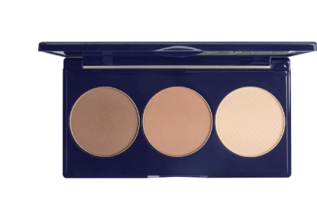
Motives
  A coordinated trio which includes a deep colour to contour areas you would like to recede, a light shade for highlighting cheekbones, and a matte bronzer to add a radiant glow. This three-in-one formula is made of ultra-light, micronized pigments that effortlessly blend to enhance skin tone and give you a flawless look and feel.
3-in-1 Contour, Bronze & Highlight Kit
sku: 7101MSD
$45.00
BENEFITS
  Three-in-one compact with powders to highlight, contour and bronze
  Luxurious formula that glides on smoothly to accentuate and sculpt facial features
  Includes easy-to-follow instructional guide on where to apply the powders
  Designed for all skin types

Slide 44
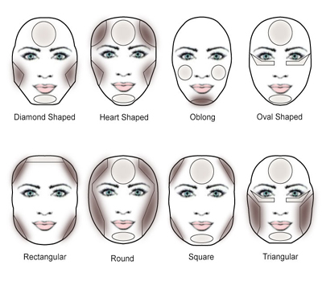
Action Item:
Decide if you want to practice a powder or cream contour. Apply your favourite powder contour product with a Motives Cheek Contour Brush.
sku: 747MBR
$21.50

Slide 45
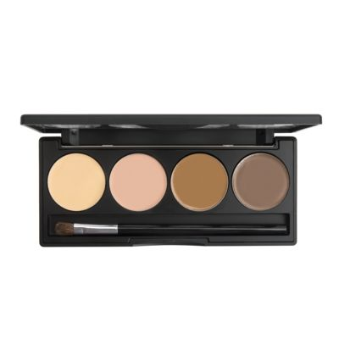
Motives Mavens
  Bringing the glamour of artists to everyday women, Motives Mavens Sculpt Series are essential contour palettes for creating flawless looks. Each palette includes four shades of crème foundation in warm and cool tones for contouring and highlighting. Handpicked by six of our Motives Mavens social media beauty sensations, these palettes give you the tools to master the art of facial sculpting.
Sculpt Series
sku: 71SSI (ice)/ 72SSF (fire)
$49.95
BENEFITS
  Chosen by six Motives Mavens as essential shades for sculpting the face
  Four shades of crème foundation in each palette for enhancing your natural features
  Perfectly sized for on-the-go application

Slide 46
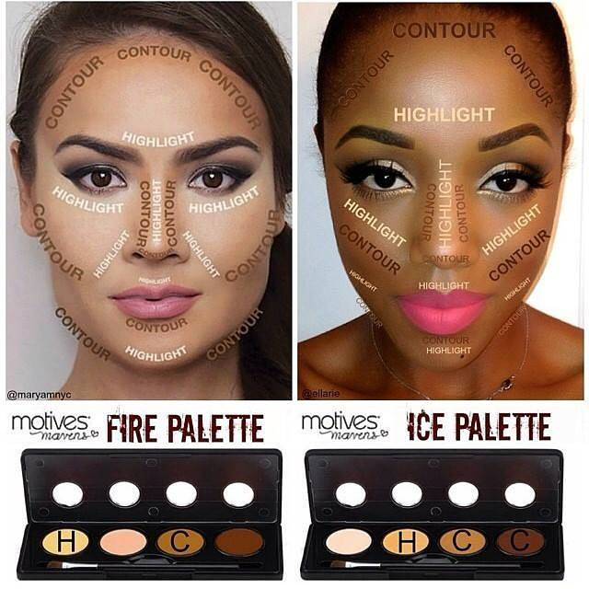
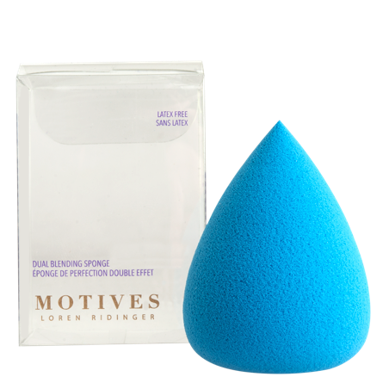
Action item:
If you chose a crème contour blend it out using the Motives Dual Blending Sponge.
sku: 720132
Please note that less is best when using the crème contour palettes
$21.50

Slide 47
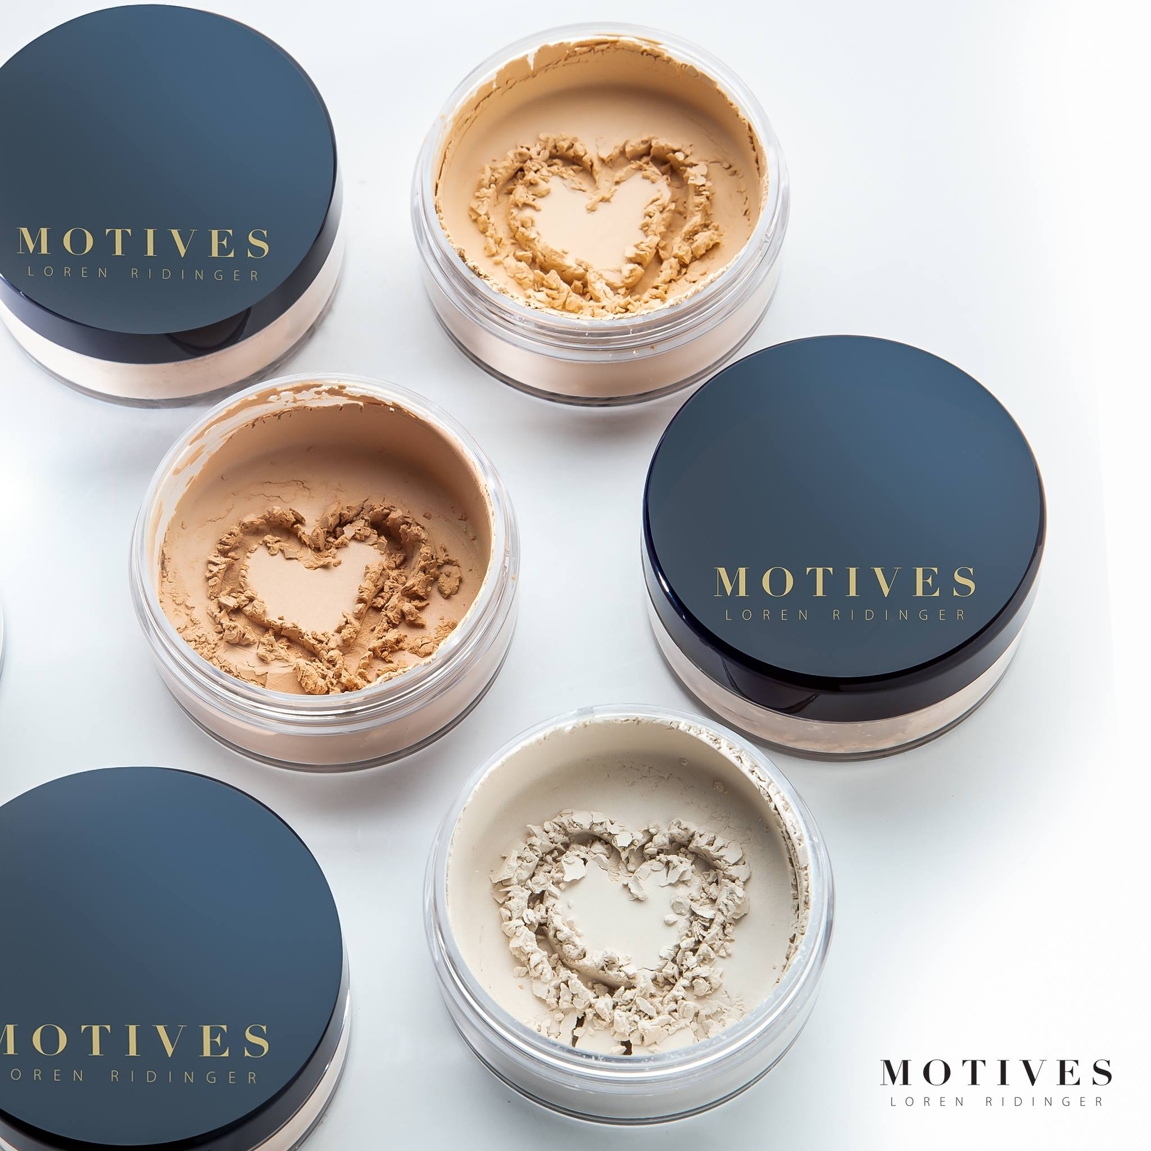
STEP 6:
Setting or Finishing Powder
  Setting powders are perfect to apply after your foundation. Anytime you use a cream or liquid, you need to set it in with setting powder so that it:
    lasts longer and doesn’t rub off
    so that your blush and bronzer blend flawlessly
    to matte out the shine.

Slide 48
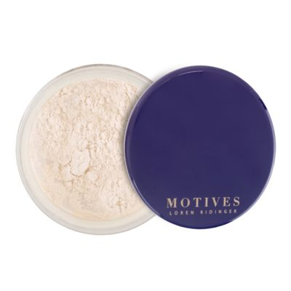
Motives
Luminous Loose Translucent Powder
  A loose powder that provides a light, silky veil and is the perfect matte finish for your foundation. The texture is beautifully smooth and can also be applied directly onto the skin. It is suitable for all skin types, even very dry skin.
Code Varies
$21.50
BENEFITS
  A beautiful, translucent powder that sets a flawless finish over any foundation without clogging the pores
  Ultra creamy, silk-soft texture
  Diffuses light, creating a flawless look
  Perfectly sets makeup
  Designed for women of all skin types and of all skin colours
  Paraben and fragrance free

Slide 49
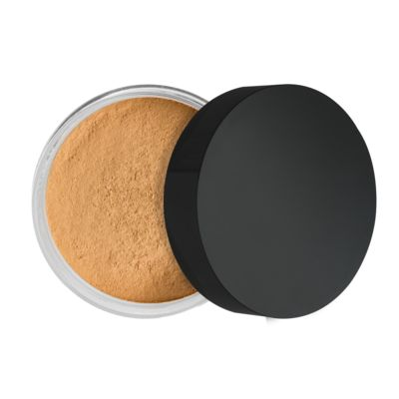
  A silky-sheer translucent loose powder formulated to create a satin-smooth finish. Use it to minimise the appearance of pores and uneven surface texture while maintaining skin's natural moisture.
  .
Motives
Translucent Loose Powder
Code Varies
$41.25
BENEFITS
  Sets makeup for a flawless finish
  Provides sheer coverage for a natural look
  Controls shine and doesn’t clog pores
  Ultra-fine texture allows for smooth application
  Formulated for women of all skin types and skin tones
  Fragrance free

Slide 50
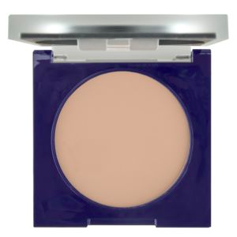
Motives
Full Coverage Photo Finish Powder
  A velvety-smooth powder that blurs fine lines for a soft and even look. This powder protects skin and absorbs shine while setting makeup to create a flawless finish. Perfect for all skin types and shades.
  .
Code Varies
$34.50
BENEFITS
  Ultra-luxurious feel with outstanding full coverage and radiance
  Powder floats across the skin for a photo finish that lasts all day
  Designed to be worn as a foundation
  Can be used over foundation for those who require special extra coverage due to scarring, hyper-pigmentation or discolouration
  Creates satin-soft skin with a radiant glow
  Provides coverage and sun protection in one formula
  For women with all skin types and of all skin colours
  Paraben and fragrance free

Slide 51
Motives
High Definition Powder
  A translucent finishing powder developed with ultra-blurring and light reflecting pigments that set makeup for an airbrushed, high-definition finish. The lightweight formula leaves an undetectable veil that reduces the appearance of shine and blurs imperfections for a beautifully smooth, matte look.
sku: 7360HDP
$39.95
BENEFITS
Ideal for achieving a high-definition, air-brushed look
Provides a soft, natural-looking matte finish
Invisible finishing powder sets makeup for longer-wear
Reduces the appearance of oil and shine
Does not streak, settle or cake on skin

Slide 52

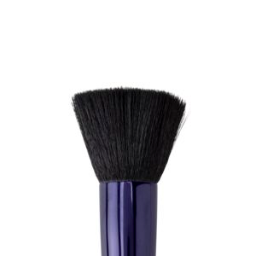
Action Item
sku: 754MBR
$26.75
Apply the desired powder with an appropriate brush. For a softer finish with less coverage, try using a larger, fluffier brush. For added coverage and more of a matte finish, you may prefer a flat top powder brush as their bristles are more concentrated
sku: 751MBR
$26.75

Slide 53
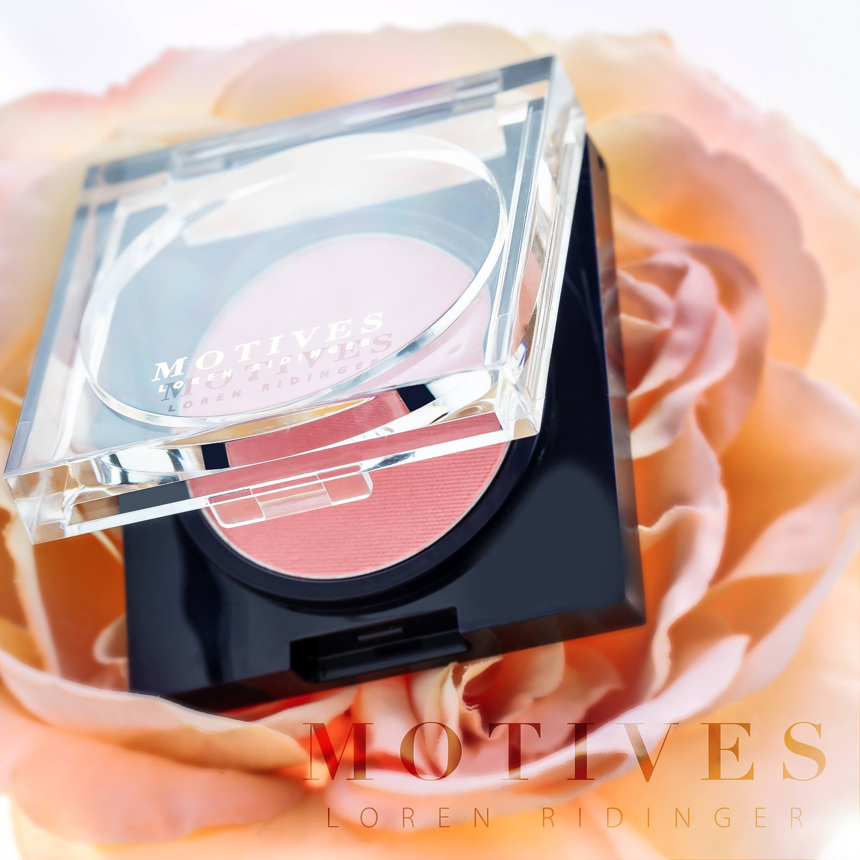
STEP 7:
BLUSH
  Blush makeup is used to simulate a natural glow and should look subtle. However, there are many ways to apply blush so that you not only add vivacity to your complexion, but also amplify your facial structure or correct your apparent face shape.

Slide 54
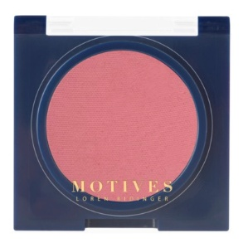
  Create perfectly flushed cheeks with this complexion-enhancing, high-quality pressed blush that provides you with a healthy glow, flattering every skin tone. Designed to be worn alone or layered together for more depth, this long-wear blush features a smooth texture and boosted colour intensity.
Motives
Pressed Blush
Code Varies
$25.25
BENEFITS
  Blends well and layers exquisitely
  Creates a natural, healthy-looking glow so skin looks renewed and flawless
  Soft and luxurious texture in a satin-smooth, non-irritating formula
  Instantly minimises the look of imperfections and visible pores
  Works well for women of all skin types and colours
  Conditions the skin without clogging pores

Slide 55
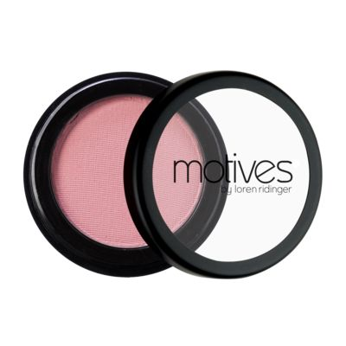
Motives
Mineral Pressed Blush
  A mineral-based blush infused with antioxidants for smoother and more hydrated skin. With enhanced minerals, this blush features smoother application, boosted colour intensity and longer wear.
Sku: 7104MBP
$24.50
BENEFITS
  Reflects light to reduce the appearance of enlarged pores and fine lines
  Velvet and creamy texture that smoothes over the skin evenly
  Translucent coverage for naturally-flushed cheeks
  Layer blush to create vivid cheeks
  Available in two shades to complement any skin tone
  Paraben free
  Talc free

Slide 56
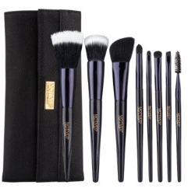
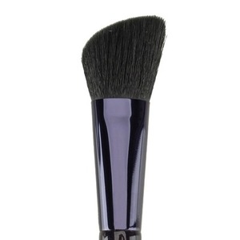
Action Item
sku: 747MBR
$21.50
sku: 746MBR
$98.25
Apply desired blush with
cheek contour brush or blush brush

Slide 57
STEP 8:
BRONZER
  Avoid using bronzer as a contour! Instead, use bronzer to mimic where the sun would hit your face naturally and where you tan the darkest. This will give you a sun-kissed look and add definition and warmth to your skin. Apply bronzer to the cheekbones, temples, and bridge of your nose. Buff it in for a seamless finish.

Slide 58
Motives
Pressed Bronzer
  With a soft and silky feel, Motives Pressed Bronzer provides a radiant summer glow during any season or can be used to provide definition to enhance facial features. This excellent formula allows for flawless application that will benefit all skin types and colours.
Code Varies
$30.50
BENEFITS
Creates a natural, healthy glow so skin looks renewed and flawless
Blends well; layers exquisitely
Soft and luxurious texture in a satin-smooth, non-irritant formula
Delivers skin conditioning and antioxidant benefits
Works well on women of all skin types and all skin colours

Slide 59

ACTION ITEM
  Avoid using bronzer as a contour! Instead, use bronzer to mimic where the sun would hit your face naturally and where you tan the darkest. This will give you a sun-kissed look and add definition and warmth to your skin. Apply bronzer to the cheekbones, temples, and bridge of your nose. Buff it in for a seamless finish.

Slide 60
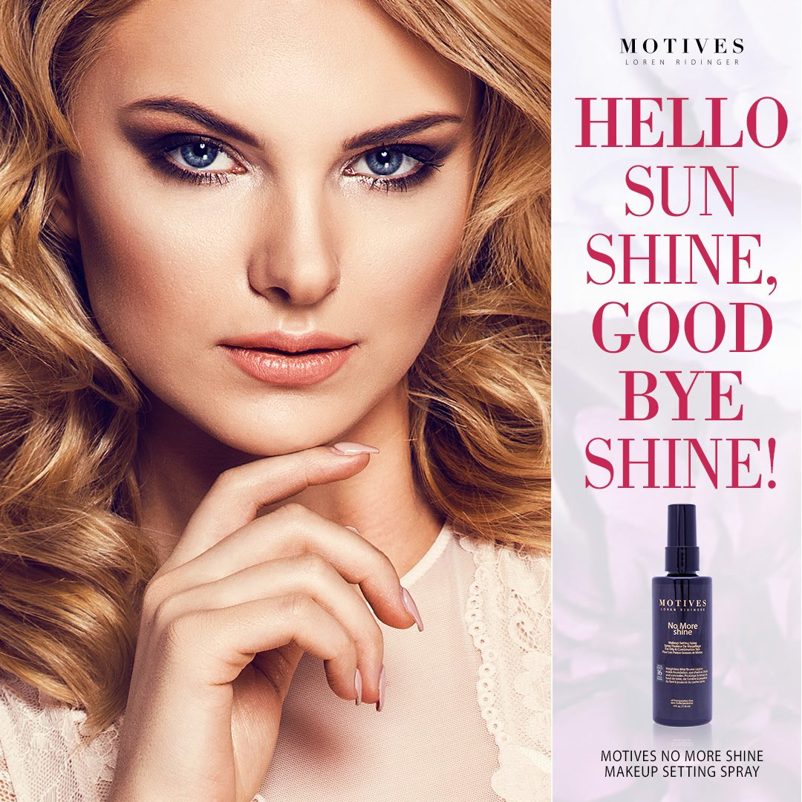
STEP 9:
SETTING SPRAY
  A makeup setting spray is quite similar to a primer, except they are applied after your makeup. Think of them like the topcoat to your makeup. Makeup setting sprays are also transparent and don’t change the colour or texture of your makeup.
    Keeps your makeup in place
    Helps prevent makeup meltdown

Slide 61
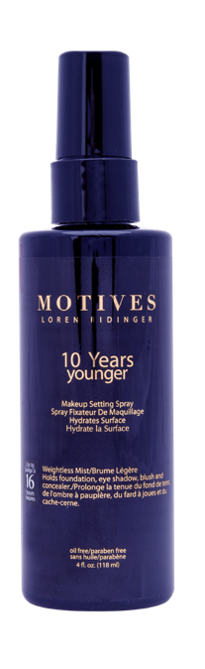
Motives
10 Years Younger Makeup Setting Spray
  A setting spray that mists on to keep makeup from smudging or settling into fine lines. Keep your makeup looking vibrant all day with skin that has a glowing, dewy, youthful complexion.
sku: 7301FS
$39.95
BENEFITS
  Helps reduce makeup slippage into pores, lines, wrinkles or scars
  Keeps makeup looking flawless day and night
  Fewer required touchups throughout the day
  Saves up to 50% of makeup usage

Slide 62
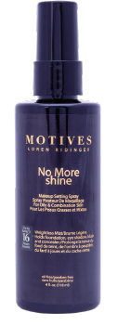
Motives
No More Shine Makeup Setting Spray
  A setting spray that mists on weightlessly to control oil, deflect surface shine and keep skin looking beautifully matte. Oily skin has met its match! Keep your skin looking smooth — but never shiny — with this spray.
sku: 7302MAS
$39.95
BENEFITS
  Helps control surface shine and absorb excess oil
  Fewer required "touch-ups" throughout the day
  Helps reduce appearance of makeup smudging or creasing
  Surface cooling technology holds temperature to avoid melting or sliding
  Works with all types of makeup
  Works great with 10 Years Younger Makeup Setting Spray

Slide 63

THE PERFECT POUT

Slide 64

EXFOLIATE, TREAT & PRIME
Prep your pout for a lip look, while hydrating and nourishing. Taking the time to do these steps will result in longer wear and a more flawless application.

Slide 65
STEP 1: APPLY
A gentle yet effective scrub that will help your lips reach their full pout potential. This nourishing formula utilises sugar to buff away dry skin to reveal supple, smooth lips that are prepped for an infusion of flawless colour.
Motives
MUAH Vanilla Lip Scrub
sku: 7502LMT
$23.25
BENEFITS
Exfoliates to buff away rough, dry flakes
Sugar crystals exfoliate lips for a softer feel
Creates a smooth base for Motives lip colour
Gentle enough for daily use

Slide 66

MOTIVES FOR LA LA RETRACTABLE LIP AND
EYE BRUSH
A retractable lip and eye shadow brush that creates perfect, long-lasting definition around the contour of the lips and on the eyes. This unique two-in-one brush makes for flawless, effortless application, at home or on the go.
sku: 31MLMBR
BENEFITS
Retractable lip brush on one side & eye brush on other
• Made from synthetic hair
• Perfect for on-the-go beauty

Slide 67
STEP 2: APPLY
Motives
A refined lip balm that soothes, plumps, hydrates and protects the lips. This lip balm also nourishes the lips, while providing moisture and hydration.
40FY Lip Treatment
sku: 7499MLT
$33.00
BENEFITS
• Helps lips appear fuller and more supple
• Helps define the contour of the lips
• Helps smooth the appearance of fine lines and wrinkles around lips
• Enhances the healthy appearance of lips

Slide 68
STEP 4:
Lip Liner

Slide 69
Motives
Lip Crayon
  A lip crayon that effortlessly glides on as a precise line for controlled application. An infusion of antioxidants pampers lips for a healthy-looking pout while maintaining an all-day stay, so you’re ready for anything. Colour outside the lines!
Code Varies
$22.75
BENEFITS
• Glides on easily for precision application
• Creamy and smooth texture applies gently, unlike most lip pencils
• Long-lasting colour
• Amazing staying power
• Non-comedogenic and hypoallergenic

Slide 70
STEP 4:
Lip Liner
ACTION ITEM
Line your lips with your choice of Motives Lip Crayon. Decide if you’d like to try to contour your lips!
  A makeup setting spray is quite similar to a primer, except they are applied after your makeup. Think of them like the topcoat to your makeup. Makeup setting sprays are also transparent and don’t change the color or texture of your makeup.
    Keeps your makeup in place
    Helps prevent makeup meltown

Slide 71
STEP 5:
Lip Stick
  Fill it in!

Slide 72
STEP 4:
Lip Liner
Motives
Velvet Lipstick
Code Varies
$27.50
• Semi-matte, velvet finish that is non-drying
• Creamy texture ensures smooth application
• Instant hydration ensures comfortable wear
• Paraben-free
  A makeup setting spray is quite similar to a primer, except they are applied after your makeup. Think of them like the topcoat to your makeup. Makeup setting sprays are also transparent and don’t change the color or texture of your makeup.
    Keeps your makeup in place
    Helps prevent makeup meltown
*Not all featured shades are available in every market.

Slide 73
STEP 4:
Lip Liner
Motives
All Day
Liquid Stick
Code Varies
$30.50
Full, long-lasting coverage for extended wearability
Creamy texture ensures perfect adherence to lips
Brilliant shine with high colour impact
Paraben free
  A makeup setting spray is quite similar to a primer, except they are applied after your makeup. Think of them like the topcoat to your makeup. Makeup setting sprays are also transparent and don’t change the color or texture of your makeup.
    Keeps your makeup in place
    Helps prevent makeup meltown
*Not all featured shades are available in every market.

Slide 74
STEP 4:
Lip Liner
Motives
Maven Mattes
Code Varies
$30.00
• Full, long-lasting coverage in a matte finish
• Minimal transfer and feathering upon application
• Creamy texture leaves lips feeling soft and smooth
• Quick dry time
• Paraben-free
  A makeup setting spray is quite similar to a primer, except they are applied after your makeup. Think of them like the topcoat to your makeup. Makeup setting sprays are also transparent and don’t change the color or texture of your makeup.
    Keeps your makeup in place
    Helps prevent makeup meltown
*Not all featured shades are available in every market.

Slide 75
STEP 4:
Lip Liner
Motives
Metallic Paints
Code Varies
$32.25
• Bold, metallic finish
• Long-lasting coverage
• Minimal transfer and feathering upon application
• Quick dry time
• Paraben-free
  A makeup setting spray is quite similar to a primer, except they are applied after your makeup. Think of them like the topcoat to your makeup. Makeup setting sprays are also transparent and don’t change the color or texture of your makeup.
    Keeps your makeup in place
    Helps prevent makeup meltown
*Not all featured shades are available in every market.

Slide 76
STEP 4:
Lip Liner
Motives
Mineral Lipstick
Code Varies
$26.75
• Moisturises and conditions for softer lips
Silky texture that glides on smooth
Vitamin E helps protect against environmental factors
Helps to inhibit moisture loss
Paraben free
  A makeup setting spray is quite similar to a primer, except they are applied after your makeup. Think of them like the topcoat to your makeup. Makeup setting sprays are also transparent and don’t change the color or texture of your makeup.
    Keeps your makeup in place
    Helps prevent makeup meltown
*Not all featured shades are available in every market.

Slide 77
STEP 4:
Lip Liner
Motives
Ultra Matte Lipstick
Code Varies
$25.25
• Intensely pigmented, matte shades
• Creamy texture ensures smooth application
• Stays true to colour for extended periods of wear
• Paraben-free
  A makeup setting spray is quite similar to a primer, except they are applied after your makeup. Think of them like the topcoat to your makeup. Makeup setting sprays are also transparent and don’t change the color or texture of your makeup.
    Keeps your makeup in place
    Helps prevent makeup meltown
*Not all featured shades are available in every market.

Slide 78
STEP 6:
Gloss
  Let it shine!

Slide 79
STEP 4:
Lip Liner
Motives
Pout Plumpers
Code Varies
$30.50
• Lips appear fuller instantly
• Creamy texture ensures perfect adherence to lips
• Adds brilliant shine to any lip look
• Paraben free

Slide 80
STEP 4:
Lip Liner
Motives
Mineral Lip Shine
Code Varies
$27.50
• Provides intense hydration and conditioning
• Provides ultra-shine to lips throughout the day and night
• Helps protect lips from dryness while providing a moisturised, healthy lip line
• Brush applicator provides increased color during application
• Paraben-free
*Not all featured shades are available in every market.

Slide 81

This Completes Your Look

